Slide 1
System Program

Slide 2
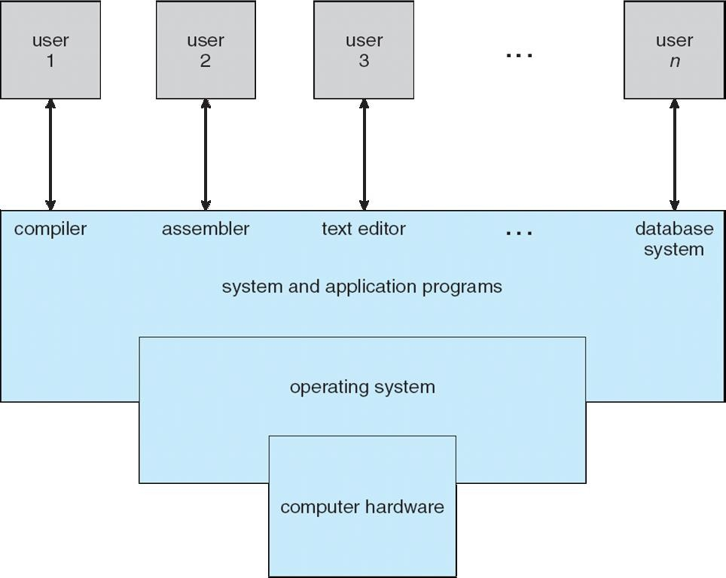
Four Components of a Computer System

Slide 3
System Programs
System programs provide a convenient environment for program development and execution. They can be divided into:
File management
Status information
File modification
Programming language support
Program loading and execution
Communications
Most users view of the operation system is defined by system programs, not the actual system calls

Slide 4
System Programs
Provide a convenient environment for program development and execution
Some of them are simply user interfaces to system calls; others are considerably
more complex
File management - Create, delete, copy, rename
Status information
Some ask the system for info - date, time, amount of available memory, disk space, number of users
Others provide detailed performance, logging, and debugging information
Typically, these programs format and print the output to the terminal or other
output devices

Slide 5
System Programs (Cont.)
File modification
Text editors to create and modify files
Special commands to search contents of files or perform transformations of the text
Programming-language support - Compilers, assemblers, interpreters
Program loading and execution- Absolute loaders, relocatable loaders, linkage editors, and
debugging systems for higher-level and machine language
Communications - Provide the mechanism for creating virtual connections among processes, users, and computer systems
Allow users to send messages to one another’s screens, browse web pages, send
electronic-mail messages, log in remotely, transfer files from one machine to another

Slide 6
System Programs (Cont.)
Background Services
Launch at boot time
Provide facilities like disk checking, process scheduling, error logging, printing
Run in user context not kernel context
Known as services, subsystems, daemons
Application programs
Don’t pertain to system
Run by users
Not typically considered part of OS
Launched by command line, mouse click

Slide 7
Operating System Design and Implementation
Design and Implementation of OS not “solvable”, but some approaches have proven successful
Internal structure of different Operating Systems can vary widely
Start the design by defining goals and specifications
Affected by choice of hardware, type of system
User goals and System goals
User goals – operating system should be convenient to use, easy to learn, reliable, safe, and fast
System goals – operating system should be easy to design, implement, and maintain, as well as flexible, reliable, error-free, and efficient

Slide 8
Operating System Design and Implementation (Cont.)
Important principle to separate
Policy: What will be done? Mechanism: How to do it?
Mechanisms determine how to do something, policies decide what will be done
The separation of policy from mechanism is a very important principle, it allows maximum flexibility if policy decisions are to be changed later
Specifying and designing an OS is highly creative task of software engineering

Slide 9
Implementation
Much variation
Early OSes in assembly language
Then system programming languages like Algol, PL/1
Now C, C++
Actually usually a mix of languages
Lowest levels in assembly
Main body in C
Systems programs in C, C++, scripting languages like PERL, Python, shell scripts
More high-level language easier to port to other hardware

Slide 10
Operating System Structure
General-purpose OS is very large program
Various ways to structure ones
Monolithic / Simple structure – MS-DOS
More complex -- UNIX
Layered approach – an abstraction
Microkernel –Mach
Modular
Hybrid

Slide 11
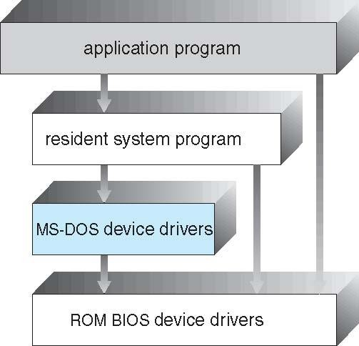
Simple Structure -- MS-DOS
MS-DOS – written to provide the most functionality in the least space
Not divided into modules
Although MS-DOS has some structure, its interfaces and levels of functionality are not well separated

Slide 12
Non Simple Structure -- UNIX
UNIX
limited by hardware functionality,
the original UNIX operating system had limited structuring. The UNIX OS consists of two separable parts
Systems programs
The kernel
Consists of everything below the system-call interface and above the physical hardware
Provides the file system, CPU scheduling, memory management, and other operating-system functions; a large number of functions for one level

Slide 13
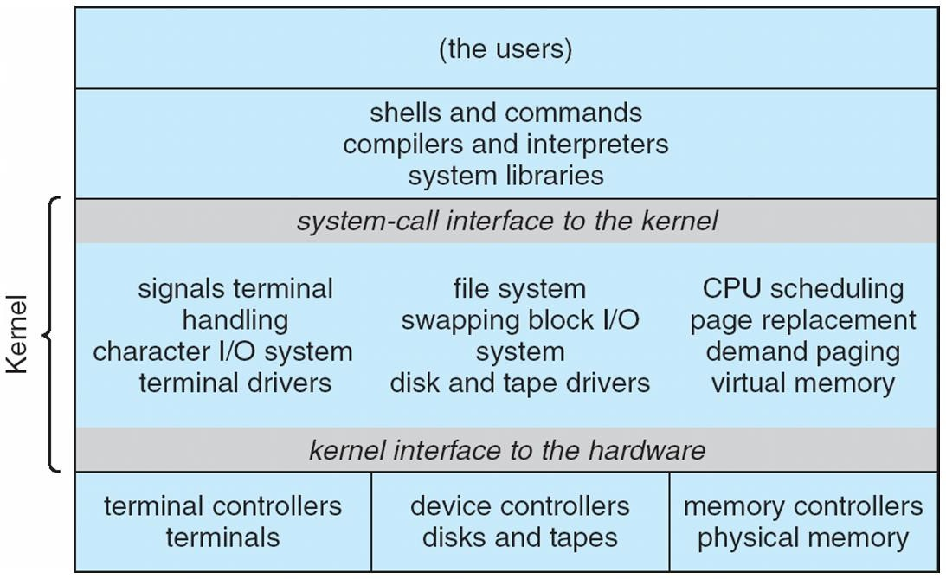
Traditional UNIX System Structure(MONOLITHIC Structure)
Beyond simple but not fully layered

Slide 14
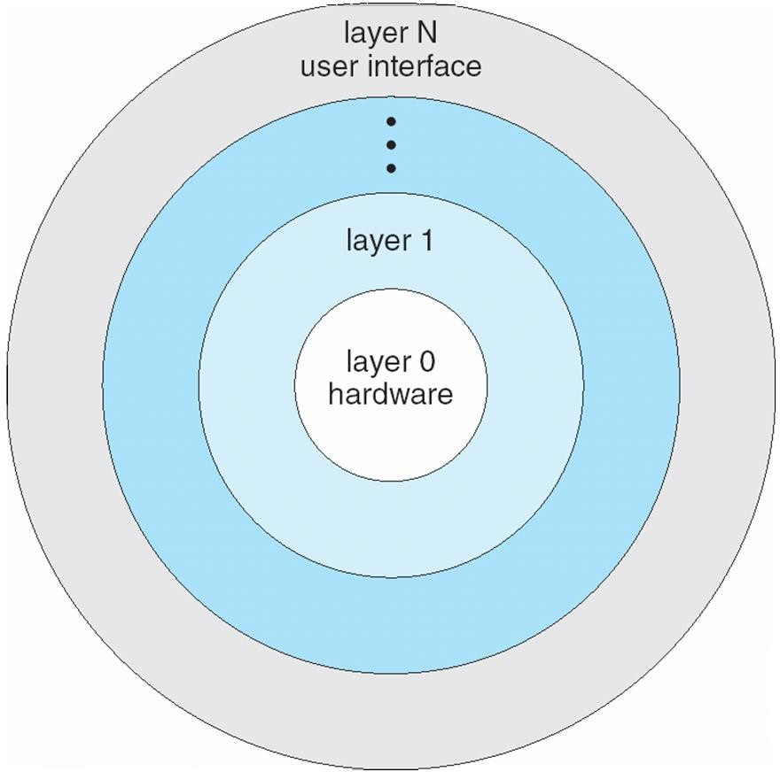
Layered Approach
The operating system is divided into a number of layers (levels), each built on top of lower layers.
The bottom layer (layer 0), is the hardware; the highest (layer N) is the user interface.
With modularity, layers are selected such that each uses (operations) and services of only lower-level layers
The main advantage is simplicity of construction and
debugging.
The main difficulty is defining the various layers.
functions

Slide 15
Microkernel System Structure
Moves as much from the kernel into user space
Mach example of microkernel
Communication takes place between user modules using message passing
Benefits:
Extending the operating system becomes much easier.
Any changes to the kernel tend to be fewer, since the kernel is smaller.
More reliable (less code is running in kernel mode)
More secure
Detriments:
Performance overhead of user space to kernel space communication

Slide 16
Microkernel System Structure
Application Program
File System
Device Driver
user mode
messages
messages
Interprocess Communication
memory managment
CPU
scheduling
kernel mode
microkernel
hardware

Slide 17



Microkernel System Structure
User Space Processes
File Management | Process Server | Device Drivers | Pager
Micro Kernel (IPC , Scheduling)
Kernel Space

Slide 18
Modules
Many modern operating systems implement loadable kernel modules
Uses object-oriented approach
Each core component is separate
Each talks to the others over known interfaces
Each is loadable as needed within the kernel
Overall, similar to layers but with more flexible
Linux, Solaris, etc

Slide 19
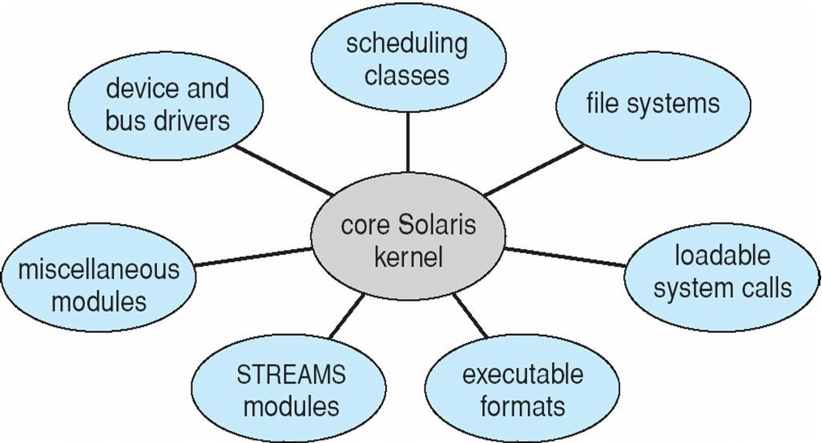
Solaris Modular Approach

Slide 20
Hybrid Systems
Most modern operating systems are actually not one pure model
Hybrid combines multiple approaches to address performance, security,
usability needs
Linux and Solaris kernels in kernel address space, so monolithic, plus modular for dynamic loading of functionality
Windows mostly monolithic, plus microkernel for different subsystem
personalities

Slide 21
Hybrid Systems
Most modern operating systems are actually not one pure model
Hybrid combines multiple approaches to address performance, security,
usability needs
Linux and Solaris kernels in kernel address space, so monolithic, plus modular for dynamic loading of functionality
Windows mostly monolithic, plus microkernel for different subsystem
personalities
Apple Mac OS X hybrid, layered, Aqua UI plus Cocoa programming environment
Below is kernel consisting of Mach microkernel and BSD Unix parts, plus I/O kit and dynamically loadable modules (called kernel extensions)

Slide 22
Mac OS X Structure
graphical user interface
Aqua
application environments and services
Java Cocoa
Quicktime
BSD
kernel environment Mach | BSD
I/O kit |  | kernel extensions

Slide 23







iOS
Apple mobile OS for iPhone, iPad
Structured on Mac OS X, added functionality
Does not run OS X applications natively
Also runs on different CPU architecture (ARM vs. Intel)
Cocoa Touch Objective-C API for developing apps
Media services layer for graphics, audio, video
Core services provides cloud computing, databases
Core operating system, based on Mac OS X kernel

Slide 24
Android
Developed by Open Handset Alliance (mostly Google)
Open Source
Similar stack to IOS
Based on Linux kernel but modified
Provides process, memory, device-driver management
Adds power management
Runtime environment includes core set of libraries and Dalvik virtual machine
Apps developed in Java plus Android API
Java class files compiled to Java bytecode then translated to executable than runs in Dalvik VM
Libraries include frameworks for web browser (webkit), database (SQLite), multimedia, smaller libc

Slide 25
Android Architecture
Applications
Application Framework
Libraries
Android runtime
SQLite
openGL
Core Libraries
surface manager
media framework
Dalvik virtual machine
webkit
libc
Linux kernel

Slide 26
Virtual Machines
A virtual machine takes the layered approach to its logical conclusion. It treats hardware and the operating system kernel as though they were all hardware
A virtual machine provides an interface identical to the underlying bare hardware
The VM creates the illusion of multiple processes, each executing on its own
processor with its own (virtual) memory

Slide 27
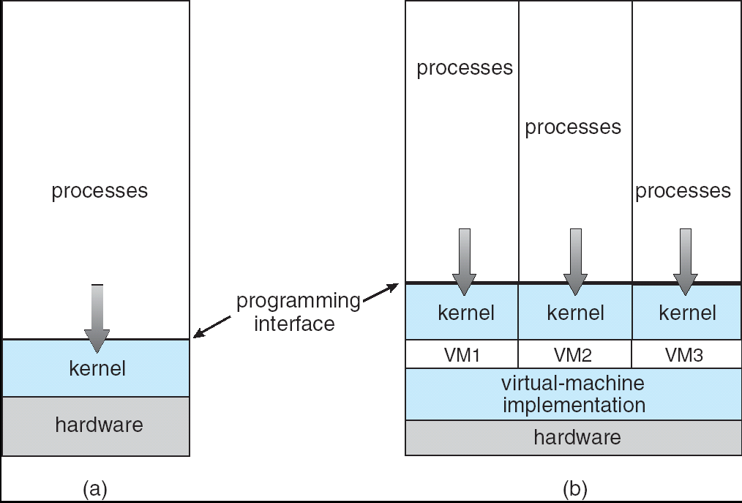
System Models
Non-virtual Machine
Virtual Machine

Slide 28
Virtual Machines - Implementation
How to create several VM when we have only one set of hardware resources?
Sharing resources
CPU
Time-shared scheduling
Printers/card readers
Spooling
Memory
Virtual memory
HD
Ha! Its not possible to have full HD for each VM!

Slide 29
Advantages/Disadvantages of Virtual Machines
Advantage:
Complete protection/isolation of system resources between VMs
Perfect vehicle for operating-systems research and development
If the OS you are developing crashes, just restart the VM
Useful when you have applications for different OSs
Disadvantage
No direct sharing of resources between different VMs
Difficult to implement completely

Slide 30
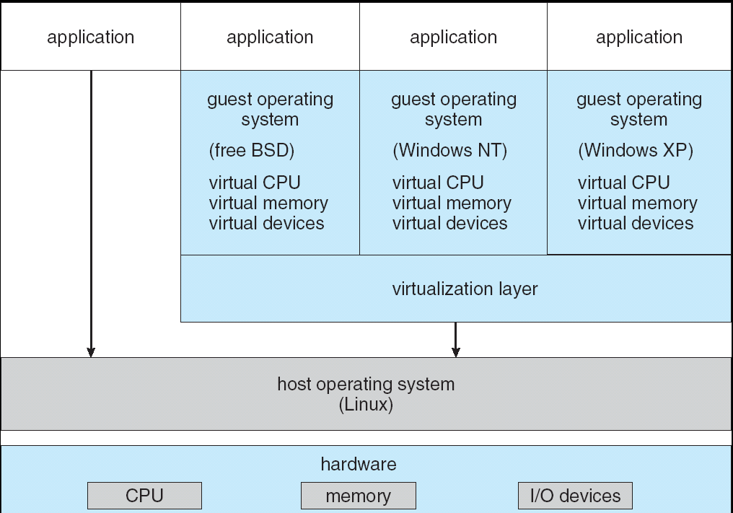
Example: VMware Architecture

Slide 31
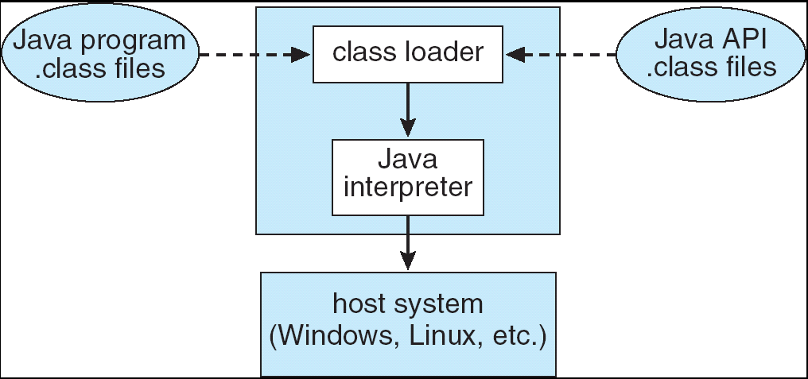
The Java Virtual Machine

